Slide 1
Chapter 23
Art in the Age of the Enlightenment, 1750–1789

Slide 2
Learning Objectives
Discuss the ways in which Enlightenment philosophy influenced the development of architecture, painting, and sculpture in the eighteenth century.
Describe the impact that Enlightenment values and Classicism had on genre and portrait painting in the second half of the eighteenth century.
Define the qualities or characteristics of Romanticism and how they surface in the art and architecture of the second half of the eighteenth century.
Discuss the mix of styles or attitudes, especially Neoclassicism, Romanticism, and the Rococo, that prevailed in the second half of the eighteenth century and how elements of these different styles can appear in a single work of art.

Slide 3
Industrial, Intellectual, and Political Revolutions
This was an age of revolution and radical change in society, thought, and politics with worldwide consequence.
When the state failed to protect and facilitate the rights of the people to be freed from political shackles, the solution was to change it; this thought justified both the American and French Revolutions.
A reverential attitude toward scientific inquiry developed that extended to studies of the natural world.
The Industrial Revolution began to replace land-based power of the aristocracy.
Romanticism developed as a counter to Enlightenment rationalism and explored emotions, imagination, and intuition.

Slide 4
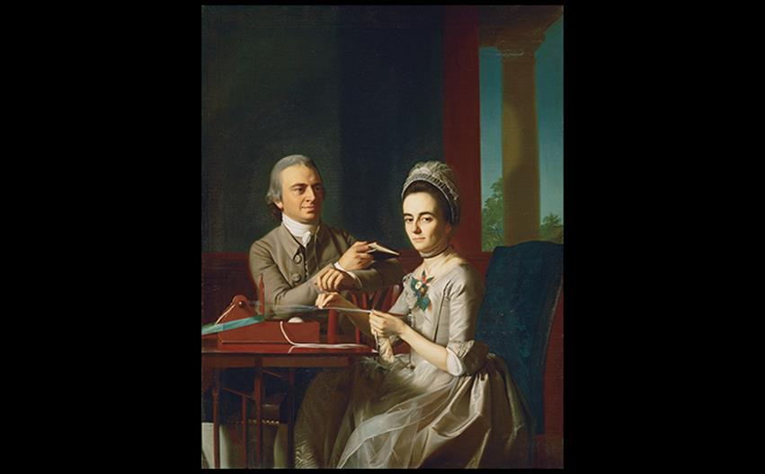
John Singleton Copley THOMAS MIFFLIN AND SARAH MORRIS (MR. AND MRS. MIFFLIN) 1773. Oil on canvas, 61-5/8" × 48" (156.5 × 121.9 cm). Philadelphia Museum of Art. © 2016. Photo Art Resource/Scala, Florence.
Notes:
John Singleton Copley THOMAS MIFFLIN AND SARAH MORRIS (MR. AND MRS. MIFFLIN) 1773. Oil on canvas, 61-5/8" × 48" (156.5 × 121.9 cm). Philadelphia Museum of Art. © 2016. Photo Art Resource/Scala, Florence.

Slide 5
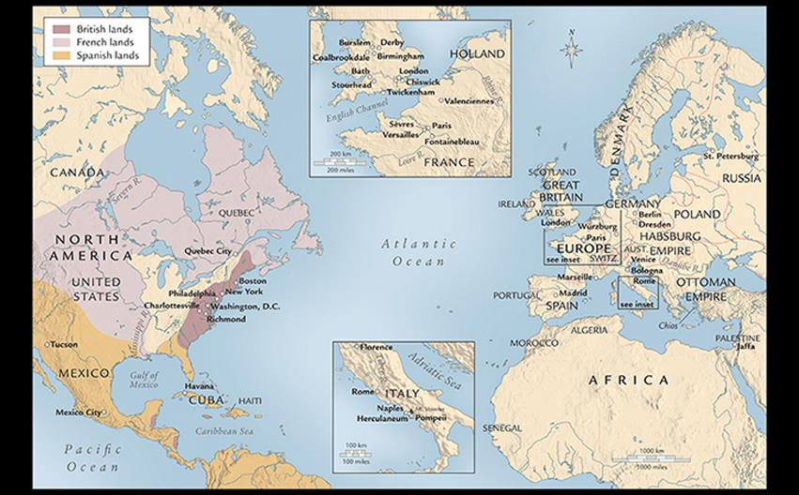
EUROPE AND NORTH AMERICA IN THE EIGHTEENTH CENTURY During the eighteenth century, three major artistic styles—Rococo, Neoclassicism, and Romanticism—flourished in Europe and North America.
Notes:
EUROPE AND NORTH AMERICA IN THE EIGHTEENTH CENTURY During the eighteenth century, three major artistic styles—Rococo, Neoclassicism, and Romanticism—flourished in Europe and North America

Slide 6
Neoclassicism in Rome (1)
Artists who contributed to the early Neoclassical movement were drawn to study and work in Rome.
Cardinal Albani sponsored a villa for the purpose of displaying his vast collection of art and artifacts.
His librarian Johann Winckelmann became the first art historian to analyze the history of art by period styles.
Mengs
Anton Raphael Mengs's Parnassus was the first full expression of Neoclassicism, featuring a scene from Classical mythology.
The pose of Apollo was copied from the Apollo Belvedere in the Vatican collection.

Slide 7
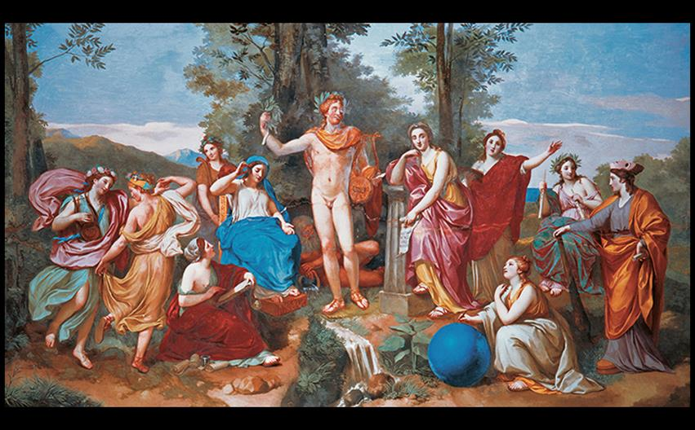
Anton Raphael Mengs PARNASSUS Ceiling fresco in the Villa Albani, Rome. 1761. © akg-images/Mondadori Portfolio/Sergio Anelli.
Notes:
Anton Raphael Mengs PARNASSUS Ceiling fresco in the Villa Albani, Rome. 1761. © akg-images/Mondadori Portfolio/Sergio Anelli.

Slide 8
Neoclassicism in Rome (2)
Canova
Antonio Canova was the leading Neoclassical sculptor of the late eighteenth century.
Pauline Borghese as Venus was an eroticized mythological sculpture originally meant for Napoleon's brother-in-law, Prince Camillo Borghese, but the recipient had it installed in a private room.

Slide 9
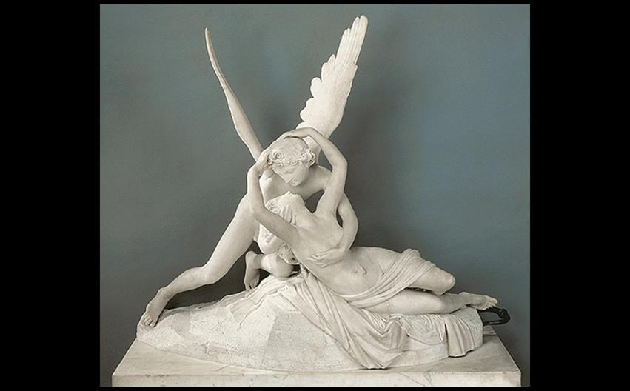
Antonio Canova CUPID AND PSYCHE 1787–1793. Marble, 61 × 68" (1.55 × 1.73 m). Musée du Louvre, Paris. Photo © Dist. RMN-Grand Palais/Raphaël Chipault.
Notes:
Antonio Canova CUPID AND PSYCHE 1787–1793. Marble, 61 × 68″ (1.55 × 1.73 m). Musée du Louvre, Paris. Photo © Dist. RMN-Grand Palais/Raphaël Chipault.

Slide 10
Neoclassicism and Early Romanticism in Britain
Late eighteenth-century Neoclassical British artists revived civic virtue through a lens of patriotism for the British nation.
Romanticism describes both the style and attitude of the subjective, emotional, and individual.
Both styles existed side by side, at times without clear distinction.

Slide 11
The Classical Revival in Architecture and Design (1 of 5)
Buildings, utensils, poetry, and fashion all gained inspiration from Classical elements.
A group of architects led by Colen Campbell challenged the extravagance of the Italian Baroque with a return to austerity and simplicity.

Slide 12
The Classical Revival in Architecture and Design (2 of 5)
Chiswick House
The Villa Rotunda served as inspiration for this Neo-Palladian house.
Richard Boyle, the third Earl of Burlington, served as designer and owner.
William Kent designed the grounds, utilizing the style of an English landscape garden, as well as the interior.

Slide 13
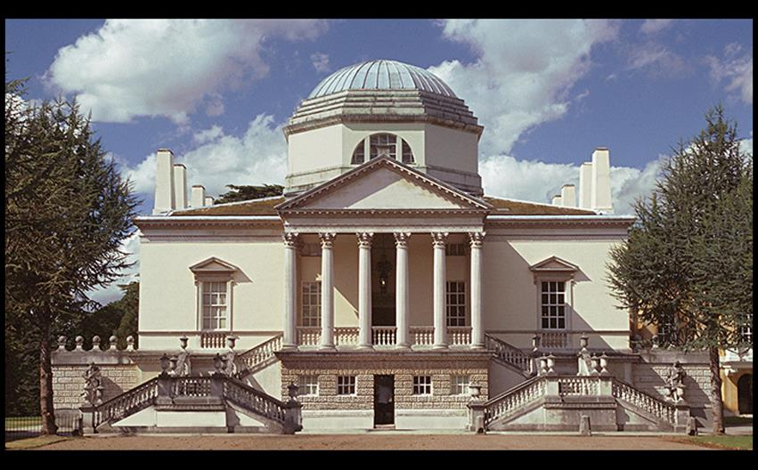
Richard Boyle (Lord Burlington) EXTERIOR VIEW OF CHISWICK HOUSE West London, England. 1724–1729. Interior decoration (1726–1729) and new gardens (1730–1740) by William Kent. © Achim Bednorz, Cologne.
Notes:
Richard Boyle (Lord Burlington) EXTERIOR VIEW OF CHISWICK HOUSE West London, England. 1724–1729. Interior decoration (1726–1729) and new gardens (1730–1740) by William Kent. © Achim Bednorz, Cologne.

Slide 14
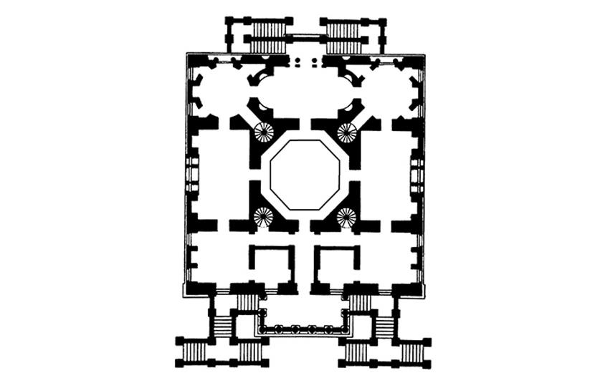
Richard Boyle (Lord Burlington) PLAN OF CHISWICK HOUSE West London, England. 1724.
Notes:
Richard Boyle (Lord Burlington) PLAN OF CHISWICK HOUSE West London, England. 1724.

Slide 15
The Classical Revival in Architecture and Design (3 of 5)
Stourhead
Henry Hoare redesigned the grounds at Stourhead with the assistance of Henry Flitcroft.
The pictureseque style was meant to mimic compositional devices of landscape painter Claude Lorrain.
It was intentionally contrived to look natural and unkempt.

Slide 16
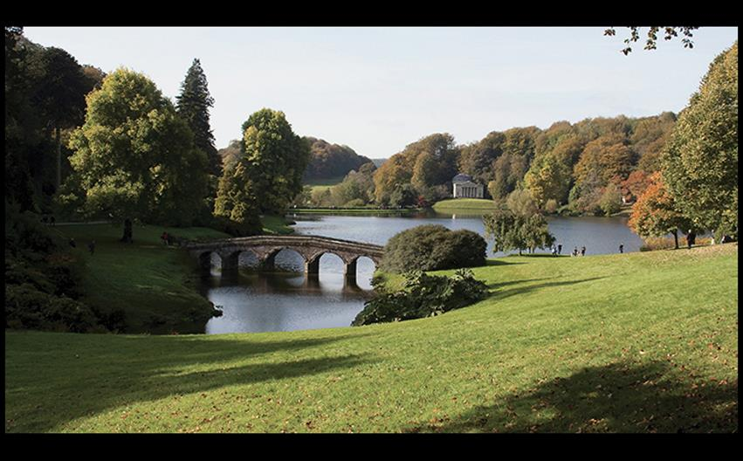
Henry Flitcroft and Henry Hoare THE PARK AT STOURHEAD Wiltshire, England. Laid out 1743, executed 1744–1765, with continuing additions. Gail Johnson/Fotolia.
Notes:
Henry Flitcroft and Henry Hoare THE PARK AT STOURHEAD Wiltshire, England. Laid out 1743, executed 1744–1765, with continuing additions. Gail Johnson/Fotolia.

Slide 17
The Classical Revival in Architecture and Design (4 of 5)
Decorative Arts
Josiah Wedgewood was a talented chemist who developed colored jasperware pottery.
The Apotheosis of Homer features white figures against a blue ground.
The design was simplified in order to accommodate mass production as well as the idealized notions of ancient Greek art.

Slide 18
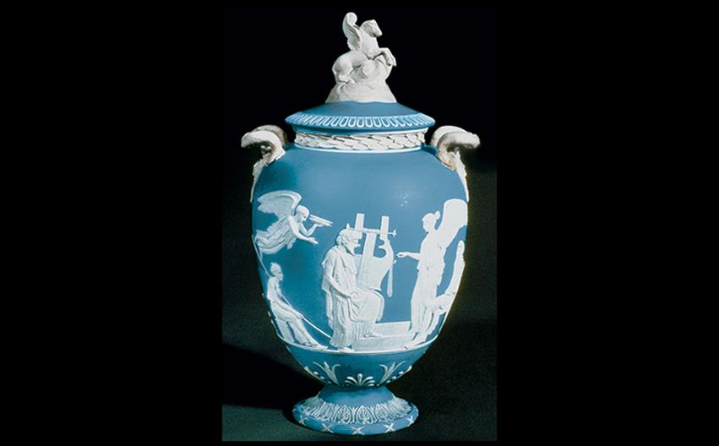
Josiah Wedgwood THE APOTHEOSIS OF HOMER Made at the Wedgwood Etruria factory, Staffordshire, England. 1790–1795. White jasperware body with a mid-blue dip and white relief, height 18" (45.7 cm). Relief of The Apotheosis of Homer adapted from a plaque by John Flaxman, Jr., 1778. Trustees of the Wedgwood Museum, Barlaston, Staffordshire, England. Photo © Wedgwood Museum/WWRD.
Notes:
Josiah Wedgwood THE APOTHEOSIS OF HOMER Made at the Wedgwood Etruria factory, Staffordshire, England. 1790–1795. White jasperware body with a mid-blue dip and white relief, height 18" (45.7 cm). Relief of The Apotheosis of Homer adapted from a plaque by John Flaxman, Jr., 1778. Trustees of the Wedgwood Museum, Barlaston, Staffordshire, England. Photo © Wedgwood Museum/WWRD.

Slide 19
The Classical Revival in Architecture and Design (5 of 5)
Decorative Arts
He was also active in the effort to abolish slavery, evident in "Am I not a man and a brother?"
He commissioned a medallion for the British Committee to Abolish the Slave Trade and sent copies to Benjamin Franklin, then-president of the Philadelphia Abolition Society.

Slide 20
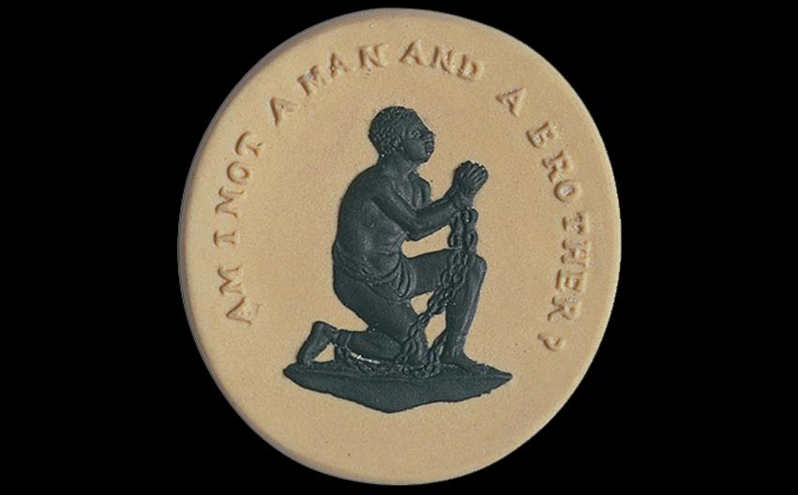
William Hackwood for Josiah Wedgwood "AM I NOT A MAN AND A BROTHER?" 1787. Black-and-white jasperware, 1-3/8" × 1-3/8" (3.5 × 3.5 cm). Trustees of the Wedgwood Museum, Barlaston, Staffordshire, England. Photo © Wedgwood Museum/WWRD.
Notes:
William Hackwood for Josiah Wedgwood "AM I NOT A MAN AND A BROTHER?" 1787. Black-and-white jasperware, 1-3/8" × 1-3/8" (3.5 × 3.5 cm). Trustees of the Wedgwood Museum, Barlaston, Staffordshire, England. Photo © Wedgwood Museum/WWRD.

Slide 21
The Gothic Revival in Architecture and Design
Horace Walpole's The Castle of Otranto was regarded as the first Gothic novel, setting the revival in motion.
He remodeled his country house, Strawberry Hill, into a Gothic castle.
The Picture Gallery inside was inspired by engravings of medieval architecture, in some places deviating to accommodate Walpole's taste.

Slide 22
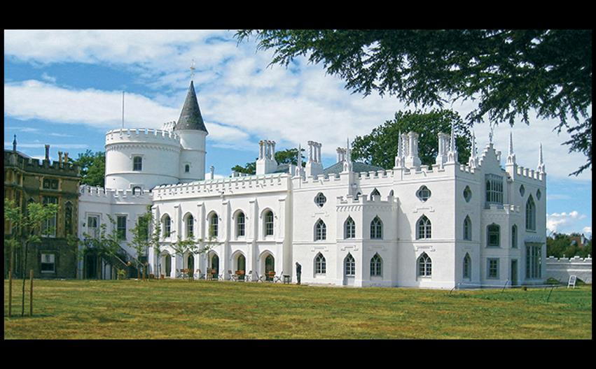
Horace Walpole and others STRAWBERRY HILL Twickenham, England. 1749–1776. Photo: Robert Neuman.
Notes:
Horace Walpole and others STRAWBERRY HILL Twickenham, England. 1749–1776. Photo: Robert Neuman.

Slide 23
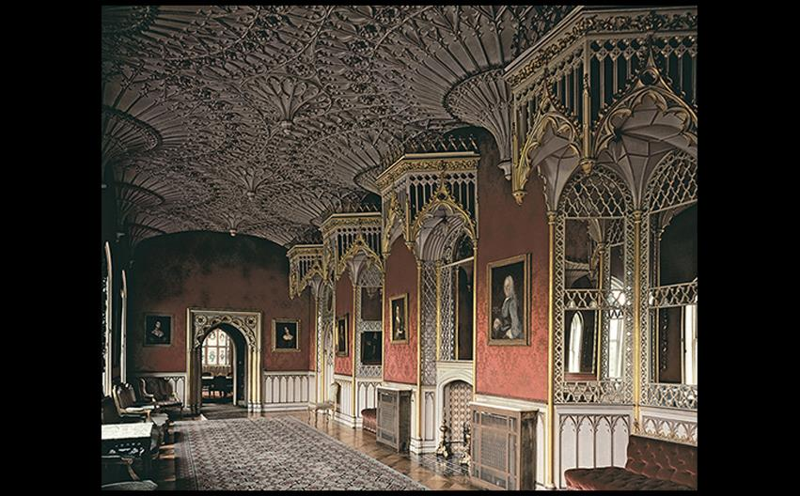
Horace Walpole, John Chute, and Richard Bentley PICTURE GALLERY SHOWING FAN-VAULTED CEILING, STRAWBERRY HILL After 1754. © akg-images /A.F.Kersting.
Notes:
Horace Walpole, John Chute, and Richard Bentley PICTURE GALLERY SHOWING FAN-VAULTED CEILING, STRAWBERRY HILL After 1754. © akg-images /A.F.Kersting

Slide 24
Iron as a Building Material
The bridge over the Severn River in England was the first large-scale example of structural metal in bridge building.
Requirements of engineering determined the form, but produced a new aesthetic that would influence cast iron works leading up to the Eiffel Tower.

Slide 25
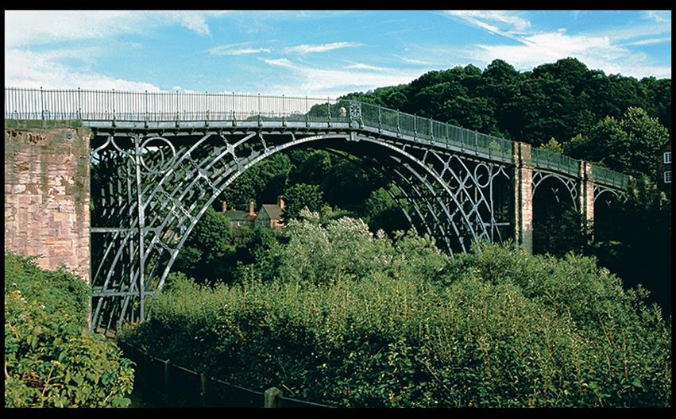
Abraham Darby III SEVERN RIVER BRIDGE Coalbrookdale, England. 1779. © Dorling Kindersley.
Notes:
Abraham Darby III SEVERN RIVER BRIDGE Coalbrookdale, England. 1779. © Dorling Kindersley.

Slide 26
Trends in British Painting (1 of 12)
Portraits remained popular for the patrons with means to commission them.
A taste developed for subjects that reflected the social change, embrace of natural beauty, and enthusiasm for technology that grew within Britain.

Slide 27
Trends in British Painting (2 of 12)
The Satiric Spirit
William Hogarth invented moralizing paintings that the then turned into prints to sell as a set to the public.
The Marriage à la Mode series promoted marriage based on love.
The Marriage Contract shows a lord arranging for his son to marry the daughter of a wealthy merchant, and the betrothed couple is entirely loveless.

Slide 28
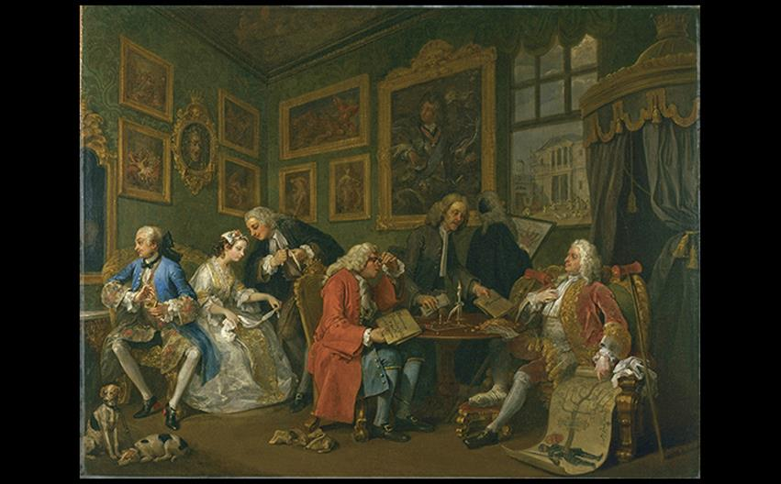
William Hogarth THE MARRIAGE CONTRACT From Marriage à la Mode, 1743–1745. Oil on canvas, 27-1/2" × 35-3/4" (69.9 × 90.8 cm). National Gallery, London. © 2016. Copyright The National Gallery, London/Scala, Florence.
Notes:
William Hogarth THE MARRIAGE CONTRACT From Marriage à la Mode, 1743–1745. Oil on canvas, 27-1/2" × 35-3/4" (69.9 × 90.8 cm). National Gallery, London. © 2016. Copyright The National Gallery, London/Scala, Florence.

Slide 29
Trends in British Painting (3 of 12)
The Satiric Spirit
Hogarth intended to create a distinctively British style without obscure mythological references.
Entertaining and amusing audiences while emphasizing the downfalls of the aristocracy led to the popularity of his works.

Slide 30
Trends in British Painting (4 of 12)
Portraiture
Sir Joshua Reynolds was appointed the first president of the Royal Academy.
Combining his own taste for history paintings with patrons' desire for portraits, he developed the Grand Manner style.
Large scale and Classical details characterize this style.

Slide 31
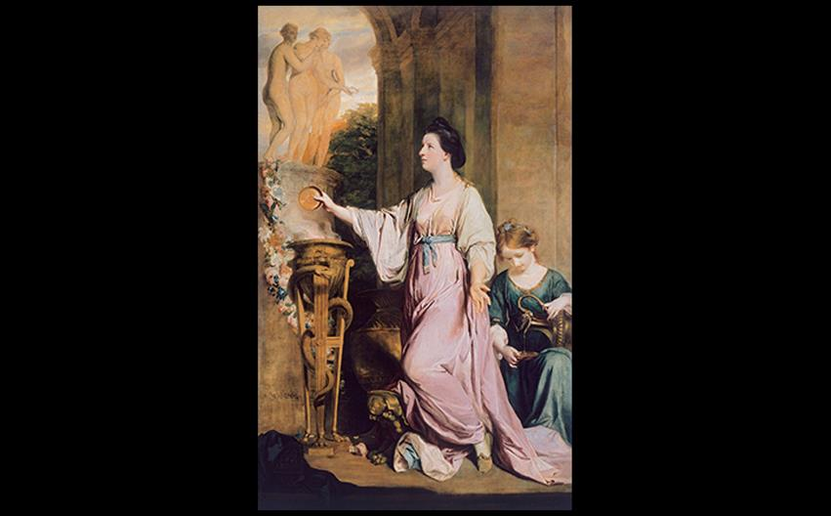
Joshua Reynolds LADY SARAH BUNBURY SACRIFICING TO THE GRACES 1765. Oil on canvas, 7'10" × 5' (2.42 × 1.53 m). The Art Institute of Chicago. Mr. and Mrs. W. W. Kimball Collection, 1922.4468. © akg-images/De Agostini Picture Lib.
Notes:
Joshua Reynolds LADY SARAH BUNBURY SACRIFICING TO THE GRACES 1765. Oil on canvas, 7'10" × 5' (2.42 × 1.53 m). The Art Institute of Chicago. Mr. and Mrs. W. W. Kimball Collection, 1922.4468. © akg-images/De Agostini Picture Lib.

Slide 32
Trends in British Painting (5 of 12)
Portraiture
The emphasis on setting in Thomas Gainsborough's portrait of Robert Andrews and Frances Carter almost turns it into a landscape painting.
Informal poses and natural landscapes were originally introduced by Van Dyck in the 1620s.

Slide 33
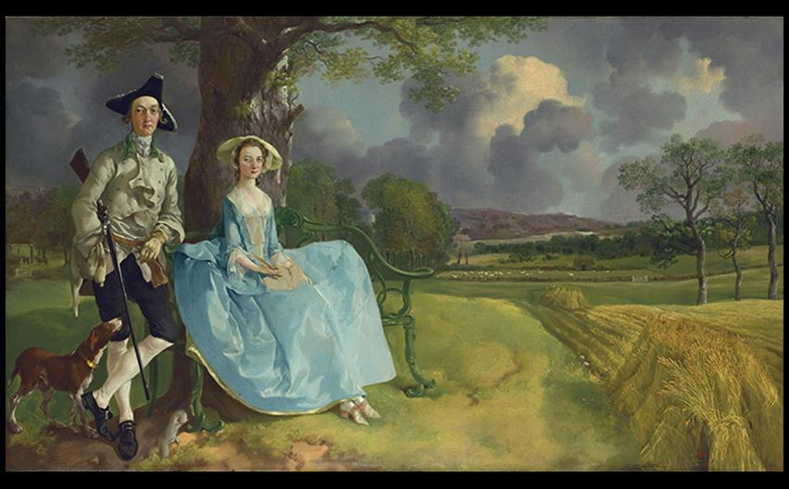
Thomas Gainsborough ROBERT ANDREWS AND FRANCES CARTER (MR. AND MRS. ANDREWS) c. 1748–1750. Oil on canvas, 27-1/2" × 47" (69.7 × 119.3 cm). National Gallery, London. © 2016. Copyright The National Gallery, London/Scala, Florence.
Notes:
Thomas Gainsborough ROBERT ANDREWS AND FRANCES CARTER (MR. AND MRS. ANDREWS) c. 1748–1750. Oil on canvas, 27-1/2" × 47" (69.7 × 119.3 cm). National Gallery, London. © 2016. Copyright The National Gallery, London/Scala, Florence. [Fig. 30-25]

Slide 34
Trends in British Painting (6 of 12)
The Romance of Science
An Experiment on a Bird in the Air-pump is Joseph Wright of Derby's example of the Enlightenment fascination with the drama and romance of science.
In it, an experiment removed the air from a glass bowl until a bird collapsed from lack of oxygen, but the bird is quickly revived.

Slide 35
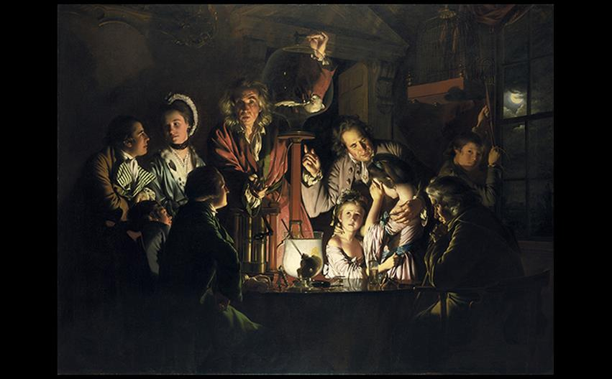
Joseph Wright of Derby AN EXPERIMENT ON A BIRD IN THE AIR-PUMP 1768. Oil on canvas, 6' × 8' (1.82 × 2.43 m). National Gallery, London. © 2016. Copyright The National Gallery, London/Scala, Florence.
Notes:
Joseph Wright of Derby AN EXPERIMENT ON A BIRD IN THE AIR-PUMP 1768. Oil on canvas, 6' × 8' (1.82 × 2.43 m). National Gallery, London. © 2016. Copyright The National Gallery, London/Scala, Florence.

Slide 36
Trends in British Painting (7 of 12)
Academies and Academy Exhibitions
History paintings were relegated to the highest place in the Academy's hierarchy of genres.
The competitive "Prix de Rome" enabled winners to study in Rome for 3–5 years.
Only seven women were admitted between 1648–1706, and admission was limited to four thereafter.

Slide 37
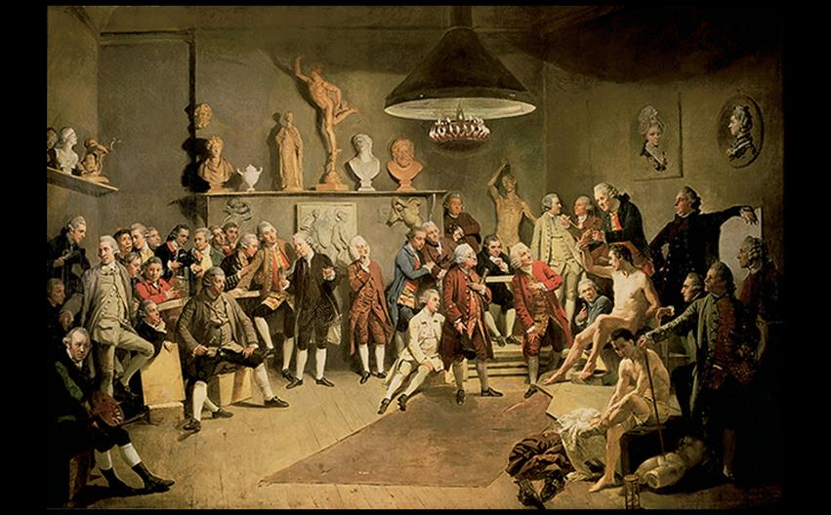
Johann Zoffany ACADEMICIANS OF THE ROYAL ACADEMY 1771–1772. Oil on canvas, 47-1/2" × 59-1/2" (120.6 × 151.2 cm). The Royal Collection, Windsor Castle, England. Royal Collection Trust © Her Majesty Queen Elizabeth II, 2016/. Bridgeman Images.
Notes:
Johann Zoffany ACADEMICIANS OF THE ROYAL ACADEMY 1771–1772. Oil on canvas, 47-1/2" × 59-1/2" (120.6 × 151.2 cm). The Royal Collection, Windsor Castle, England. Royal Collection Trust © Her Majesty Queen Elizabeth II, 2016/. Bridgeman Images.

Slide 38
Trends in British Painting (8 of 12)
History Painting
Angelica Kauffmann embarked on an independent career in history painting despite the trend of women specializing in portraiture or still life.
Cornelia Pointing to Her Children as Her Treasures illustrates a moral lesson from ancient Republican Rome, and glorifies the idealized "good mother."

Slide 39
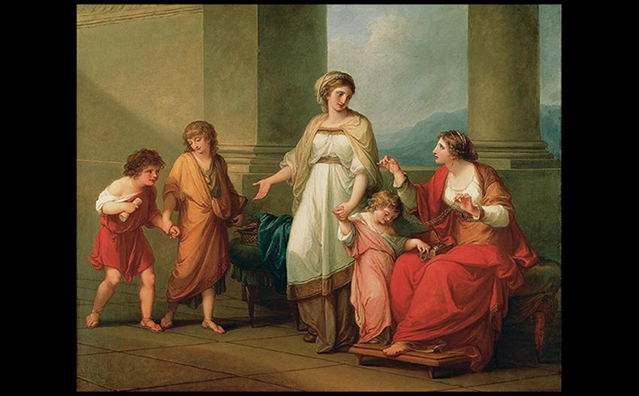
Angelica Kauffmann CORNELIA POINTING TO HER CHILDREN AS HER TREASURES c. 1785. Oil on canvas, 40 × 50" (101.6 × 127 cm). Virginia Museum of Fine Arts, Richmond, Virginia. The Adolph D. and Wilkins C. Williams Fund. Virginia Museum of Fine Arts, Richmond. Photo: Katherine Wetzel.
Notes:
Angelica Kauffmann CORNELIA POINTING TO HER CHILDREN AS HER TREASURES c. 1785. Oil on canvas, 40 × 50" (101.6 × 127 cm). Virginia Museum of Fine Arts, Richmond, Virginia. The Adolph D. and Wilkins C. Williams Fund. Virginia Museum of Fine Arts, Richmond. Photo: Katherine Wetzel.

Slide 40
Trends in British Painting (9 of 12)
History Painting
American-born Benjamin West broke with tradition in his The Death of General Wolfe.
It was a "modern history" painting depicting a contemporary subject in an elevated scene not meant to be perceived as an objective recording.
Poses suggest a Lamentation of the dead Christ.

Slide 41
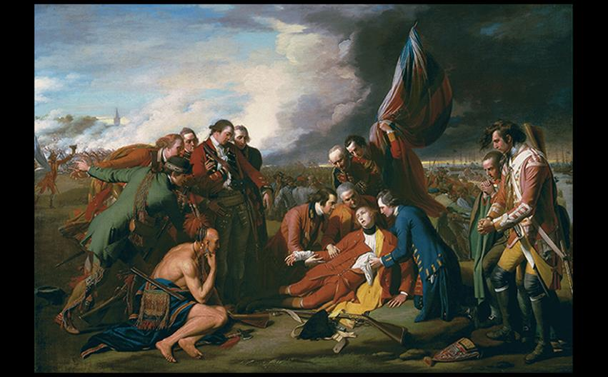
Benjamin West THE DEATH OF GENERAL WOLFE 1770. Oil on canvas, 4'11-1/2" × 7' (1.51 × 2.14 m). National Gallery of Canada, Ottawa. Transfer from the Canadian War Memorials, 1921. Gift of the 2nd Duke of Westminster, Eaton Hall, Cheshire, 1918. National Gallery of Canada, Ottawa.
Notes:
Benjamin West THE DEATH OF GENERAL WOLFE 1770. Oil on canvas, 4'11-1/2" × 7' (1.51 × 2.14 m). National Gallery of Canada, Ottawa. Transfer from the Canadian War Memorials, 1921. Gift of the 2nd Duke of Westminster, Eaton Hall, Cheshire, 1918. National Gallery of Canada, Ottawa.

Slide 42
Trends in British Painting (10 of 12)
Romantic Painting
John Henry Fuseli glorified Romanticism in works such as The Nightmare, which was both irrational and erotic in its depiction of a sleeping woman oppressed by a demon sitting on her chest.
A horse bursting into the scene from the curtains adds frightening effect.

Slide 43
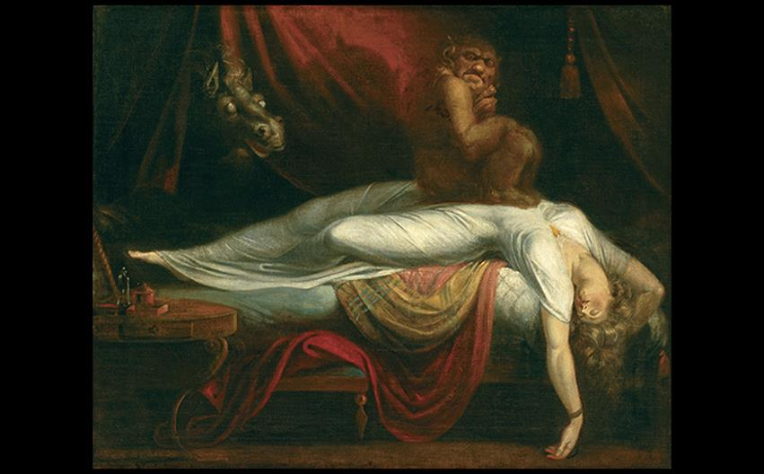
John Henry Fuseli THE NIGHTMARE 1781. Oil on canvas, 39-3/4" × 49-1/2" (101 × 127 cm). The Detroit Institute of Arts. Founders Society purchase with Mr. and Mrs. Bert L. Smokler and Mr. and Mrs. Lawrence A. Fleischmann funds. Bridgeman Images
Notes:
John Henry Fuseli THE NIGHTMARE 1781. Oil on canvas, 39-3/4" × 49-1/2" (101 × 127 cm). The Detroit Institute of Arts. Founders Society purchase with Mr. and Mrs. Bert L. Smokler and Mr. and Mrs. Lawrence A. Fleischmann funds. Bridgeman Images.

Slide 44
Trends in British Painting (11 of 12)
Romantic Painting
Poet, painter, and printmaker William Blake was interested in examining the nature of good and evil.
The large print Newton was included in a series of prophetic prints and depicted the epitome of eighteenth-century rationalism.

Slide 45
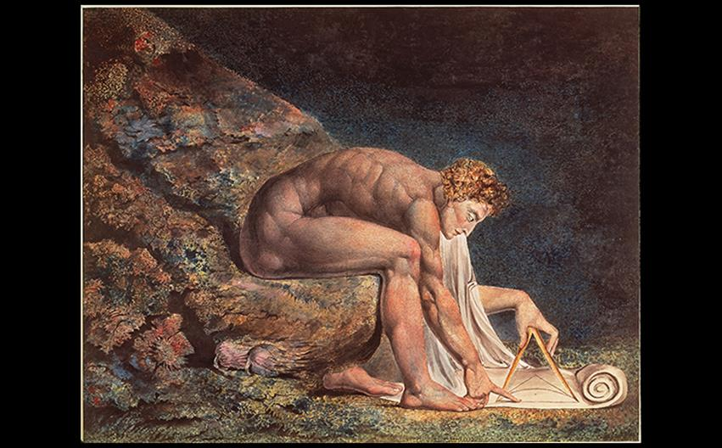
William Blake NEWTON 1795–c. 1805. Color print finished in ink and watercolor, 18-1/8" × 23-5/8" (46 × 60 cm). Tate, London. Photo © Peter Willi/ARTOTHEK.
Notes:
William Blake NEWTON 1795–c. 1805. Color print finished in ink and watercolor, 18-1/8" × 23-5/8" (46 × 60 cm). Tate, London. Photo © Peter Willi/ARTOTHEK. [Fig. 30-31]

Slide 46
Trends in British Painting (12 of 12)
Romantic Painting
John Singleton Copley became a painter of modern history.
Watson and the Shark is an example of a work with figures inspired by Classical sources, but a gruesome subject.
The inclusion of the African figure reflected a debate in British Parliament about the American slave trade; it could indicate Watson's sympathy for slaves.

Slide 47
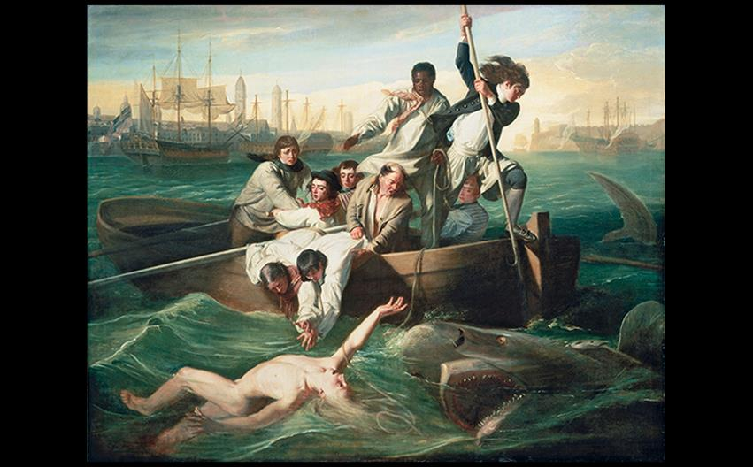
John Singleton Copley WATSON AND THE SHARK 1778. Oil on canvas, 5'10-3/4" × 7'6-1/2" (1.82 × 2.29 m). National Gallery of Art, Washington, DC. Ferdinand Lammot Belin Fund. Image courtesy the National Gallery of Art, Washington.
Notes:
John Singleton Copley WATSON AND THE SHARK 1778. Oil on canvas, 5'10-3/4" × 7'6-1/2" (1.82 × 2.29 m). National Gallery of Art, Washington, DC. Ferdinand Lammot Belin Fund. Image courtesy the National Gallery of Art, Washington.

Slide 48
Later Eighteenth-Century Art in France
The Enlightenment threw out the extravagance of the Rococo style.
French art and architecture held closer to Classical styles as the Neoclassical movement took hold.

Slide 49
Architecture
Jacques-Germain Soufflot's Panthéon exemplifies the Neoclassical style of architecture in Paris.
The building's ordered plan and sparse decoration reflect severity and simplicity.
Elements are drawn from ancient Roman temples, Wren's St. Paul's Cathedral, and Chiswick House.

Slide 50
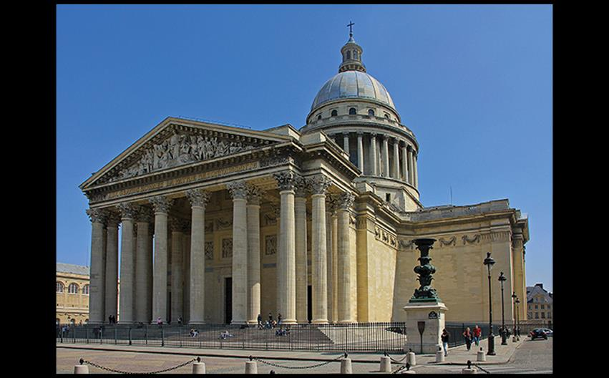
Jacques-Germain Soufflot PANTHÉON (CHURCH OF SAINTE-GENEVIÉVE), PARIS 1755–1792. JonRob/Fotolia.
Notes:
Jacques-Germain Soufflot PANTHÉON (CHURCH OF SAINTE-GENEVIÉVE), PARIS 1755–1792. JonRob/Fotolia.

Slide 51
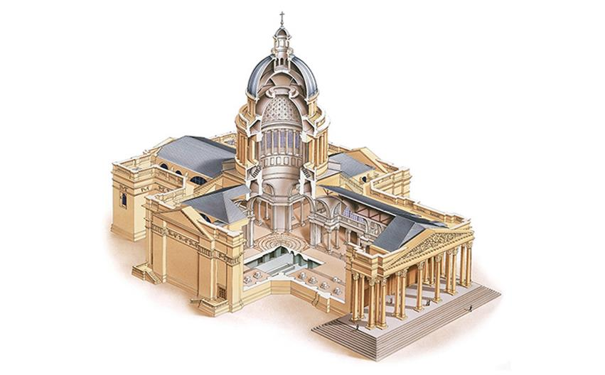
CUTAWAY ILLUSTRATION OF THE PANTHÉON © Dorling Kindersley.
Notes:
CUTAWAY ILLUSTRATION OF THE PANTHÉON © Dorling Kindersley.

Slide 52
Painting (1 of 8)
Denis Diderot was a leading detractor of Rococo in the 1760s.
His Encyclopédie served as an archive of Enlightenment through France.
He believed that art's function was to "inspire virtue and purify manners" that Rococo could never satisfy.

Slide 53
Painting (2 of 8)
Chardin
Jean-Siméon Chardin's Saying Grace illustrates a mother setting the table for a meal in front of her two children.
This genre painting extols the virtues of daily moral goodness in order to live a proper political and familial life.

Slide 54
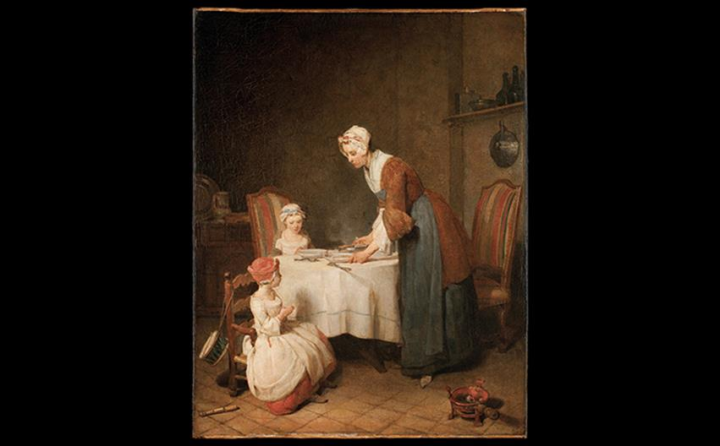
Jean-Siméon Chardin SAYING GRACE c. 1740. Oil on canvas, 19 × 15-1⁄8″ (49 × 38 cm). Musée du Louvre, Paris. Photo © Musée du Louvre, Dist. RMN-Grand Palais/Angèle Dequier.
Notes:
Jean-Siméon Chardin SAYING GRACE c. 1740. Oil on canvas, 19 × 15-1⁄8″ (49 × 38 cm). Musée du Louvre, Paris. Photo © Musée du Louvre, Dist. RMN-Grand Palais/Angèle Dequier.

Slide 55
Painting (3 of 8)
Greuze
Jean-Baptiste Greuze specialized in reflecting Diderot's drame bourgeois and "middle tragedy" through domestic genre paintings.
The Village Bride appeals to the notion that poverty and virtue can coexist.

Slide 56
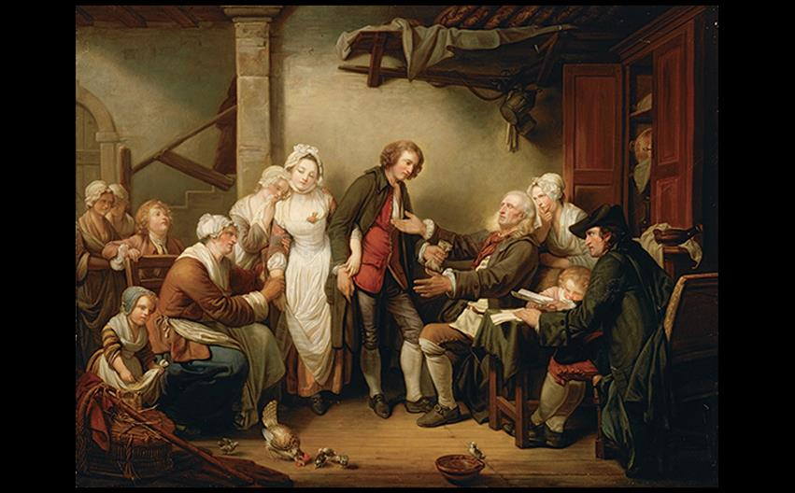
Jean-Baptiste Greuze THE VILLAGE BRIDE, OR THE MARRIAGE, THE MOMENT WHEN A FATHER GIVES HIS SON-IN-LAW A DOWRY 1761. Oil on canvas, 36" × 46 1/2" (91.4 × 118.1 cm). Musée du Louvre, Paris. Photo © RMN-Grand Palais (musée du Louvre)/Franck Raux.
Notes:
Jean-Baptiste Greuze THE VILLAGE BRIDE, OR THE MARRIAGE, THE MOMENT WHEN A FATHER GIVES HIS SON-IN-LAW A DOWRY 1761. Oil on canvas, 36" × 46 1/2" (91.4 × 118.1 cm). Musée du Louvre, Paris. Photo © RMN-Grand Palais (musée du Louvre)/Franck Raux.

Slide 57
Painting (4 of 8)
Vigée-Lebrun
Marie-Louise-Élisabeth Vigée-Lebrun's Portrait of Marie Antoinette with Her Children is in a more restrained style, depicting Marie Antoinette as a "good mother" despite her reputation.

Slide 58
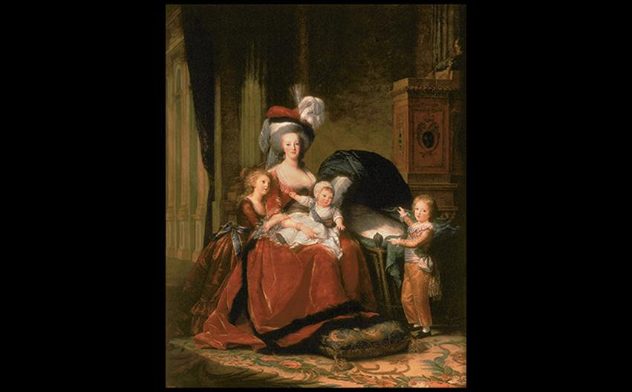
Marie-Louise-Élisabeth Vigée-Lebrun PORTRAIT OF MARIE ANTOINETTE WITH HER CHILDREN 1787. Oil on canvas, 9'-1/2" × 7'-5/8" (2.75 × 2.15 m). Musée National du Château de Versailles. © Jean Feuillie/Centre des monuments nationaux.
Notes:
Marie-Louise-Élisabeth Vigée-Lebrun PORTRAIT OF MARIE ANTOINETTE WITH HER CHILDREN 1787. Oil on canvas, 9'-1/2" × 7'-5/8" (2.75 × 2.15 m). Musée National du Château de Versailles. © Jean Feuillie/Centre des monuments nationaux.

Slide 59
Painting (5 of 8)
David
Jacques-Louis David dominated French art for over 20 years during the French Revolution and reign of Napoleon.
The Oath of the Horatii was inspired by Pierre Corneille's drama, Horace, but the scene occurs neither in the drama nor any ancient text.
It became an ironic emblem of the 1789 French Revolution.

Slide 60
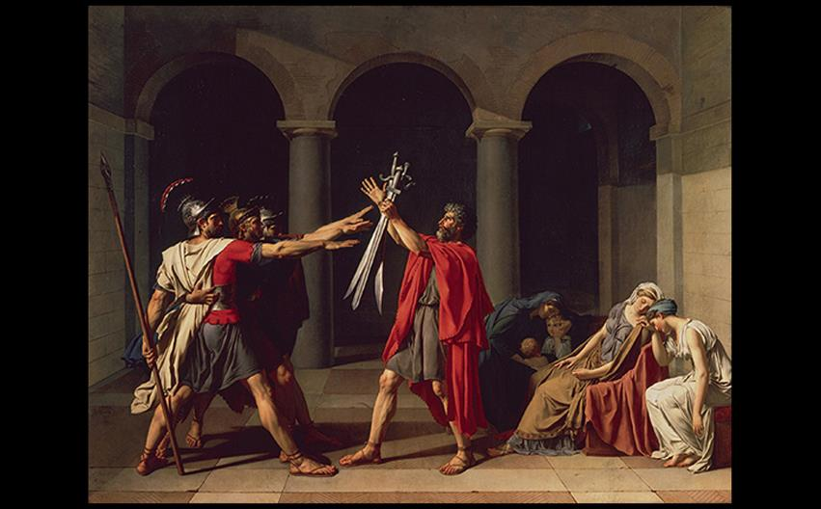
Jacques-Louis David OATH OF THE HORATII 1784–1785. Oil on canvas, 10'8-1/4" × 14' (3.26 × 4.27 m). Musée du Louvre, Paris. Photo © RMN-Grand Palais (musée du Louvre)/ Gérard Blot/Christian Jean.
Notes:
Jacques-Louis David OATH OF THE HORATII 1784–1785. Oil on canvas, 10'8-1/4" × 14' (3.26 × 4.27 m). Musée du Louvre, Paris. Photo © RMN-Grand Palais (musée du Louvre)/ Gérard Blot/Christian Jean.

Slide 61
Painting (6 of 8)
David
Death of Marat depicts not the violent stabbing of Jean-Paul Marat, but the melodramatic aftermath.
Marat's pose implies that he was a martyr for the people.
David, a Jacobin, was arrested twice when the Jacobins lost power, but re-emerged during the height of Napoleon's ascendancy.

Slide 62
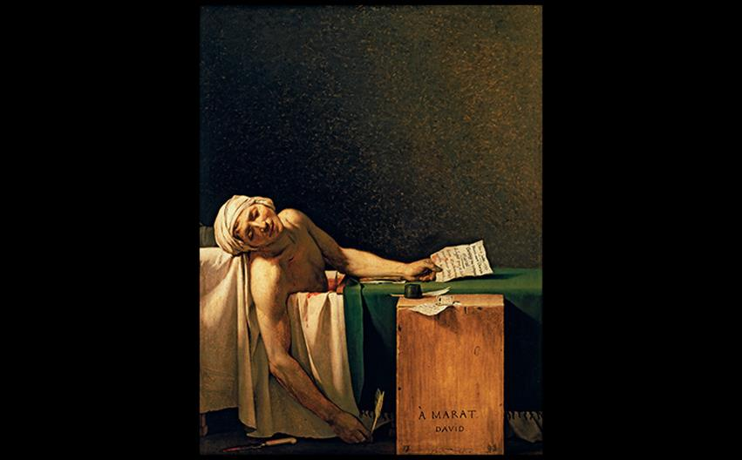
Jacques-Louis David DEATH OF MARAT 1793. Oil on canvas, 5'5" × 4'2-1/2" (1.65 × 1.28 m). © Royal Museums of Fine Arts of Belgium, Brussels. © Royal Museums of Fine Arts of Belgium, Brussels/Photo: J. Geleyns - Roscan.
Notes:
Jacques-Louis David DEATH OF MARAT 1793. Oil on canvas, 5'5" × 4'2-1/2" (1.65 × 1.28 m). © Royal Museums of Fine Arts of Belgium, Brussels. © Royal Museums of Fine Arts of Belgium, Brussels/Photo: J. Geleyns - Roscan.

Slide 63
Painting (7 of 8)
Girodet-Trioson and Labille Guiard
Anne-Louis Girodet-Trioson's Portrait of Jean-Baptiste Belley was a political statement.
The subject was a former slave who had led the campaign to abolish slavery in the colonies, particularly Saint-Domingue (now Haiti).

Slide 64
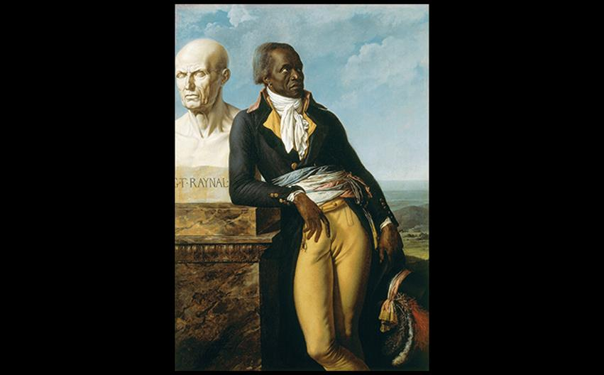
Anne-Louis Girodet-Trioson PORTRAIT OF JEAN-BAPTISTE BELLEY 1797. Oil on canvas, 5'2-1/2" × 3'8-1/2" (1.59 × 1.13 m). Musée National du Château de Versailles. Photo © RMN-Grand Palais (Château de Versailles)/Gérard Blot.
Notes:
Anne-Louis Girodet-Trioson PORTRAIT OF JEAN-BAPTISTE BELLEY 1797. Oil on canvas, 5'2-1/2" × 3'8-1/2" (1.59 × 1.13 m). Musée National du Château de Versailles. Photo © RMN-Grand Palais (Château de Versailles)/Gérard Blot.

Slide 65
Painting (8 of 8)
Girodet-Trioson and Labille Guiard
Adélaïde Labille-Guiard petitioned for the entry of women into the French Academy in 1790.
Her Self-Portrait with Two Pupils was submitted to the Salon of 1785.
The only male in this painting is her father, shown in bust behind her canvas—a role usually designated for women.

Slide 66
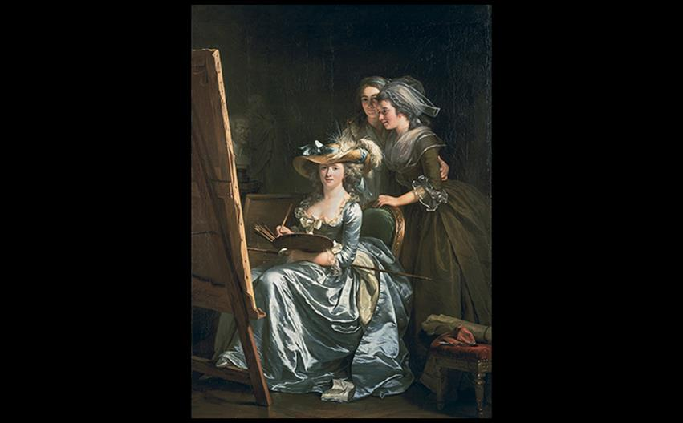
Adélaïde Labille-Guiard SELF-PORTRAIT WITH TWO PUPILS 1785. Oil on canvas, 6'11" × 4'11-1/2" (2.11 × 1.51 m). Metropolitan Museum of Art, New York. Gift of Julia A. Berwind, 1953 (53.225.5). © 2016. Image copyright The Metropolitan Museum of Art/Art Resource/Scala, Florence.
Notes:
Adélaïde Labille-Guiard SELF-PORTRAIT WITH TWO PUPILS 1785. Oil on canvas, 6'11" × 4'11-1/2" (2.11 × 1.51 m). Metropolitan Museum of Art, New York. Gift of Julia A. Berwind, 1953 (53.225.5). © 2016. Image copyright The Metropolitan Museum of Art/Art Resource/Scala, Florence.

Slide 67
Sculpture
Houdon
Jean-Antoine Houdon was commissioned to make the portrait statue of George Washington to be installed in the Virginia state capitol building.
The sculpture dresses Washington in modern clothes, but poses him in a Classical manner.

Slide 68
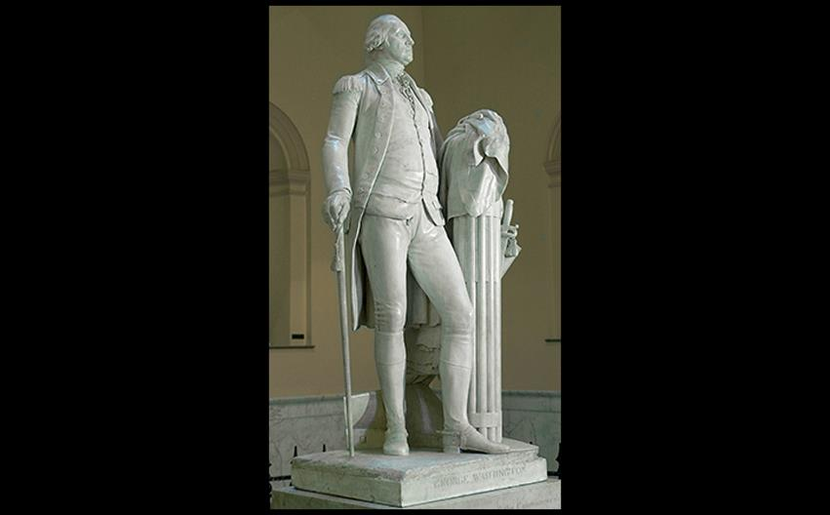
Jean-Antoine Houdon GEORGE WASHINGTON 1788–1792. Marble, height 6'2" (1.9 m). State Capitol, Richmond, Virginia.
Notes:
Jean-Antoine Houdon GEORGE WASHINGTON 1788–1792. Marble, height 6'2" (1.9 m). State Capitol, Richmond, Virginia.

Slide 69
Spain and Spanish America
Spanish artists did not embrace Neoclassicism with as much enthusiasm as the Baroque style.
Court painter Francisco Goya shaped art at the end of the eighteenth century.
Colonial art and architecture intermingled Spanish Baroque with the traditions of native peoples.

